Slide 1
Overview
HealthCare Connect serves 20,000 registered patients, with substantial chronic-care demand and material revenue-cycle questions requiring management attention.
Presenter: Gordon Moenga

Slide 2
Executive Scorecard
Headline indicators:
20,000 registered patients
14,929 recorded chronic-disease patients
5,487 patients aged over 65
5,000 reported appointments
919.95M reported outstanding amount
The health center faces both a high recorded chronic-care burden and a significant reported collection challenge. Label the outstanding amount as provisional until reconciled.

Slide 3
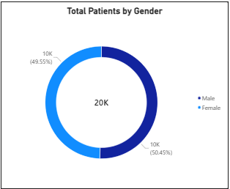
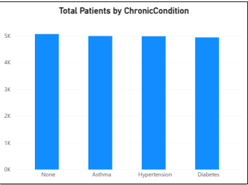
Patient Profile and Population Needs
The population is evenly split by gender, while chronic-disease records and the older-patient cohort support a stronger focus on coordinated long-term care.
Decision requested: Approve a chronic-care improvement initiative.

Slide 4
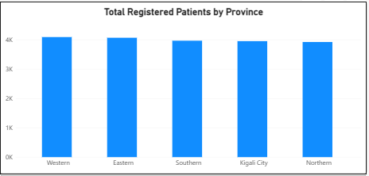
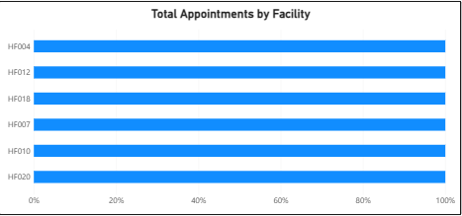
Geographic Reach and Service Demand
Patients by Province
Western: 4,091
Eastern: 4,067
Southern: 3,967
Kigali City: 3,952
Northern: 3,923
Appointments by Province
Western: 1,051
Northern: 1,021
Eastern: 1,006
Southern: 978
Kigali City: 944
Business Insight: Patient and appointment volumes are relatively balanced across provinces. Resource allocation should consider staffing, capacity, and access to care.

Slide 5
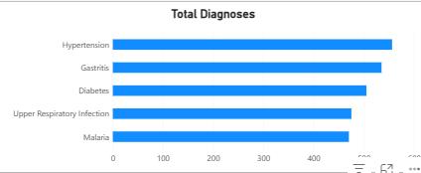
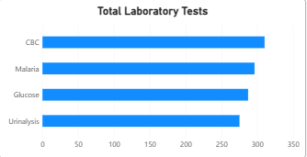
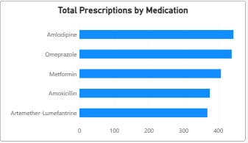
Clinical Trends and Resource Planning
Most Recorded Diagnoses
Gastritis: 12,208
Diabetes: 12,083
Hypertension: 12,075
Malaria: 11,878
Upper Respiratory Infection: 11,756
Most Prescribed Medications
Amlodipine: 1,068
Omeprazole: 1,040
Metformin: 999
Amoxicillin: 979
Artemether-Lumefantrine: 914
Business Insight: Diagnosis and prescription trends can guide medicine procurement, laboratory planning, and chronic-care services. Diagnosis counts should be validated before being interpreted as unique patients.

Slide 6
Service Delivery and Operational Performance
Emergency appointments: 1,650
Average length of hospital stay: 5.49 days
Average appointments per doctor: 14.29
Highest receiving referral facility: HF014
Referrals received by HF014: 258
Management Priorities
Monitor emergency waiting times.
Improve referral coordination between facilities.
Review bed capacity and discharge processes.
Align staffing with service demand.

Slide 7
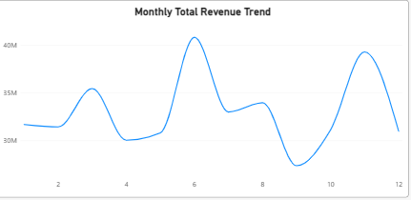
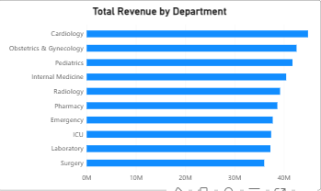
Revenue Performance
Monthly Revenue Highlights
Highest revenue month: June — 70.17 million
Lowest revenue month: September — 57.25 million
Top Revenue-Generating Departments
Cardiology — 86.25 million
Radiology — 82.00 million
Laboratory — 78.56 million
Top Facility by Billed Revenue
HF011 — 44.21 million
Business Insight: Revenue fluctuates across months and departments. Performance should be assessed alongside patient volumes, service mix, and payment collection.

Slide 8
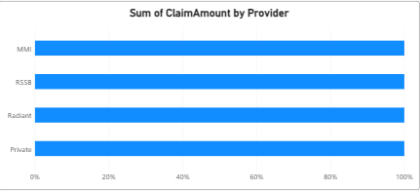
Collections and Insurance Claims
Reported outstanding balance: 919.95 million
Total reported insurance claims: 4.88 billion
Approved claims: approximately 2.44 billion
Pending claims: approximately 2.44 billion
Key Challenges
Pending insurance claims
Outstanding patient and payer balances
Potential delays in collections
Differences between financial totals across dashboard tables
Recommended Action: Reconcile billing, payments, claims, and outstanding balances before confirming the financial position.

Slide 9
Data Reliability and Reporting Risks
Issues Identified
Repeated phone numbers requiring validation
Insurance coverage records requiring confirmation
Diagnosis counts that may include multiple records per patient
Financial totals that do not fully reconcile
Potential inconsistencies in categories and reporting definitions
Recommended Improvements
Validate patient records and identifiers.
Standardize KPI definitions.
Review table relationships and aggregation logic.
Establish routine data-quality checks.
Key Message: Reliable data supports better clinical, operational, and financial decisions.

Slide 10
Recommendations and Next Steps
Priority 1: Financial Control
Reconcile payments, billing, outstanding balances, and insurance claims.
Priority 2: Patient Care
Strengthen chronic disease management and patient follow-up.
Priority 3: Operational Efficiency
Review staffing, facility capacity, emergency services, and referral processes.
Priority 4: Data Quality
Validate records, KPI definitions, and dashboard calculations.
90-Day Action Plan
Days 1–30: Validate data and reconcile financial records.
Days 31–60: Implement targeted clinical and financial improvements.
Days 61–90: Review performance indicators and report progress.
Expected Outcome: Better patient care, improved operational efficiency, and stronger financial accountability.
Thank You

